Slide 1
School of Nutrition & Dietetics Fall Orientation
September 2023

Slide 2
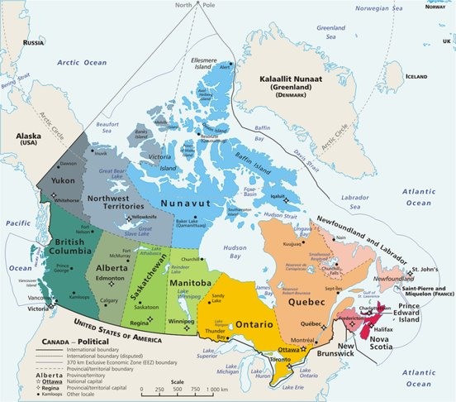
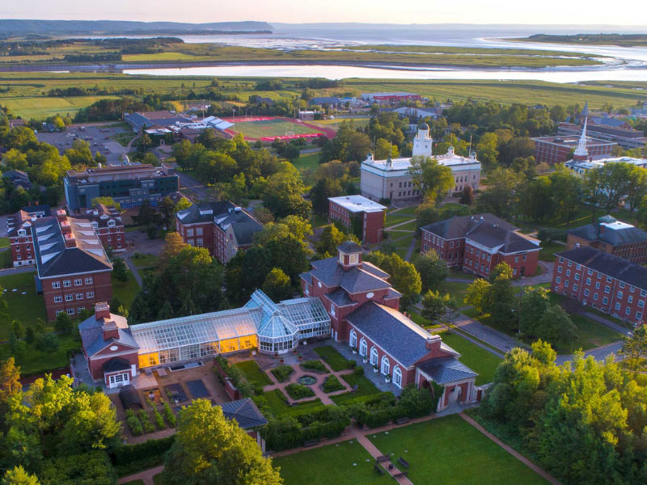
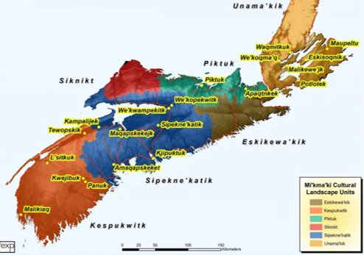
Acadia University is located in Mtaban (Wolfville), Mi'kma'ki (Nova Scotia), the ancestral and unceded territory of the Mi'kmaq, Peskotomuhkati (Passamaquoddy), and Wolastoqiyik (Maliseet) people, on the east coast of Turtle Island (Canada). The land, relationships, and our roles and responsibilities as treaty people are governed by the Treaties of Peace and Friendship, 1725-1779.
Maps courtesy of Ta’n Weji-squlia’tiek (Mi’kmaw Place Names and Digital Atlas) https://www.mapdev.ca/placenames/
Find out more about where you are from, where you live, work, and play at Whose Land?
Notes:
Jen

Slide 3
Purpose
Introduce the staff and faculty and describe our work and roles in SND
Provide “need to know information” to survive and thrive in the first few months
Introduce you to student societies and the leadership teams
Orient you to resources on campus where you may go for help
Tour SND’s labs and classrooms
Notes:
Connie

Slide 4
COVID Protocols
Strong recommendation to get fully vaccinated
PLEASE CONTINUE TO PROTECT OURSELF AND OTHERS
If experiencing symptoms of illness, please stay at home.
If unable to, please wear a mask and follow all public health directives and recommendations while moving around campus. Protecting yourself and others is essential.
Take personal precautions to keep themselves and others healthy.
Please be considerate of others with health conditions that place them in high-risk categories or live with individuals with high-risk health concerns.
Remember to respect those who choose to wear masks in public places
If you feel sick, stay home!
Notes:
As of April 30, 2023, the University will drop its masking mandate. We will continue monitoring the epidemiology of COVID-19 and its variants and take action as health and safety authorities recommend.
PLEASE CONTINUE TO PROTECT YOURSELF AND OTHERS

Slide 5
University....?
Notes:
What are your expectations...for your professors and for yourself?
What do you want your professors to know about you?

Slide 6
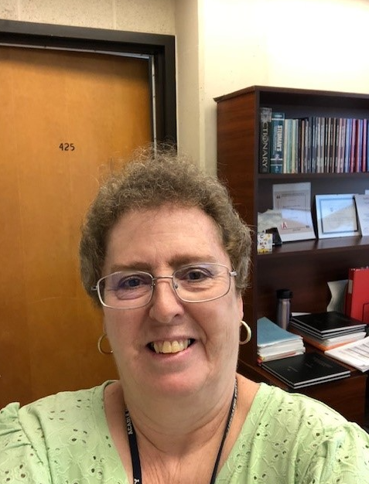
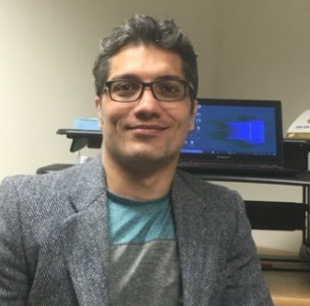
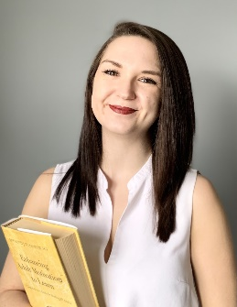
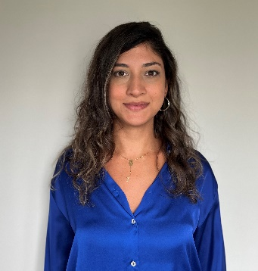
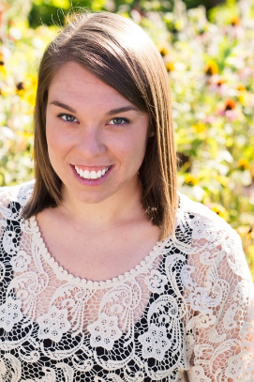
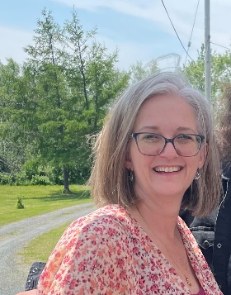
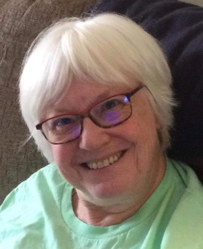
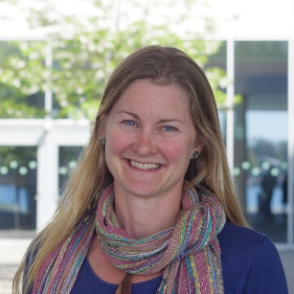
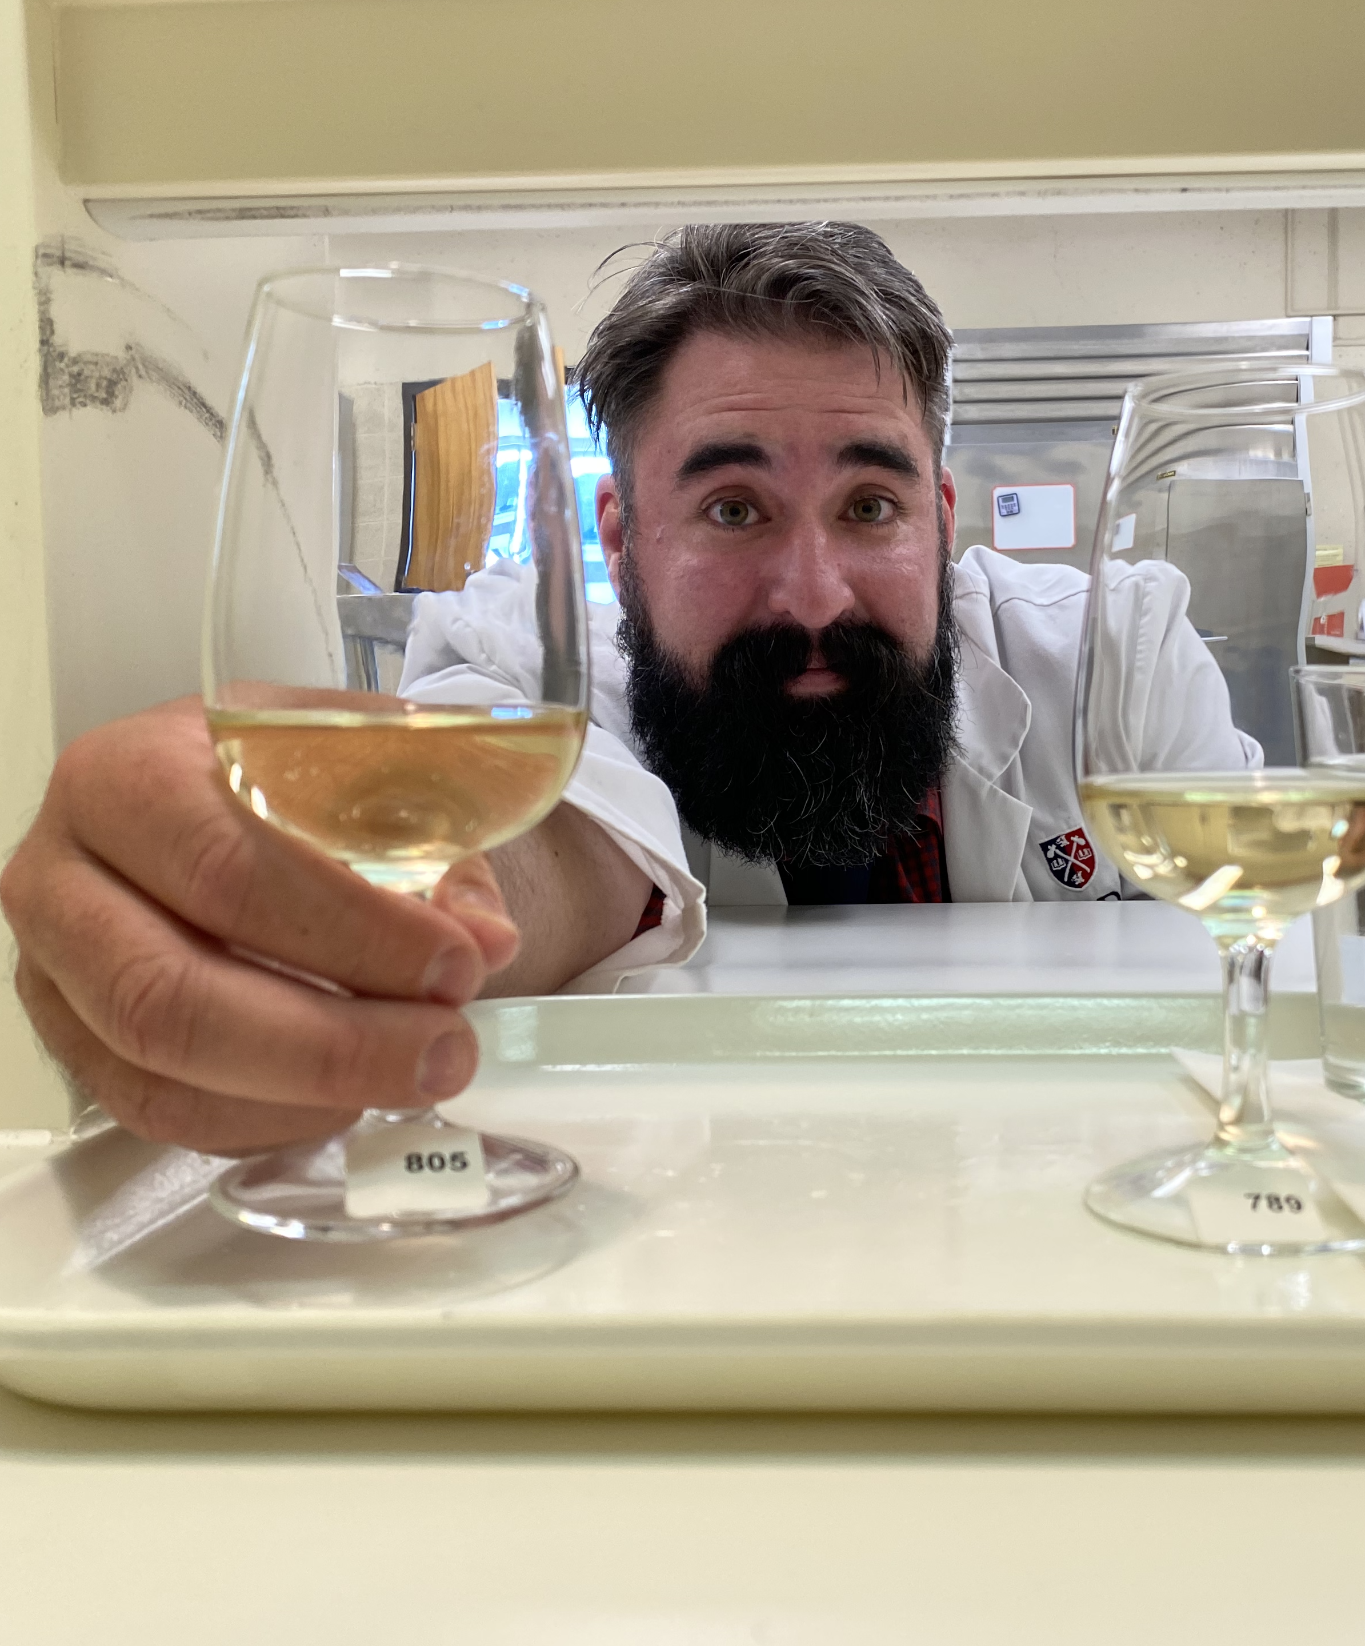
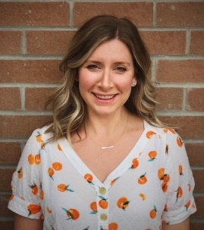
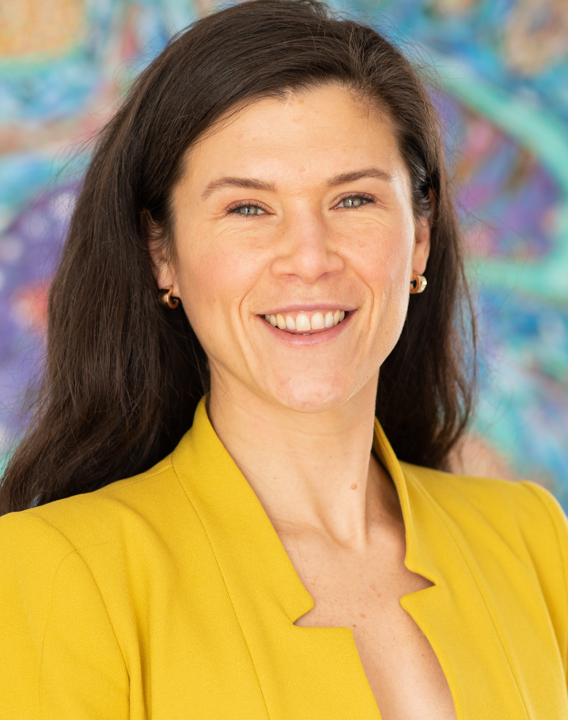
Our Faculty and Staff We are here for you!
Lynn Coleman (Admin Assistant)
Connie Foote (Interim Director)
Jamal Amyoony
Dr. Jennifer Brady
Dr. Liesel Carlsson
Dr. Matt Durant
Laurel Ettinger
Dr. Jane Francis
Dr. Moji Kaviani
Judy Lowe
Dr. Matt McSweeney
Acacia Puddester
SND Fall Orientation
Notes:
All...briefly say hello, welcome, and share an elevator pitch of your research and teaching
Update and add pictures

Slide 7
What do these folks do all day?
Teaching
~five courses per year
Practicum supervision
Research
Applying for research money to fund projects, planning projects, collecting research data, publishing
Service
Committees, boards, and organizational roles at Acadia and community and industry partners
Notes:
Jen

Slide 8
Time for some fun!

Slide 9
How do I address my course instructors?
Best to start off using Dr. XYZ until invited otherwise by the course instructor
Cordial, courteous, and semi-formal tone and language
Punctuated and grammatically correct text
Clear, concise message and subject line with course code and name if appropriate

Slide 10
BSN Programs and Advising Sheets
Our BSN degree is a four-year program if you take and pass five courses in each fall and winter term
Core nutrition courses are only offered once per academic year
Many first- and second-year courses are prerequisites for third- and fourth- year courses
Careful planning is important; make use of the BSN advising sheets found here on SND website
Notes:
Lynn

Slide 11
Using your Acadia email (and often) is a must
Our Faculty and staff will communicate with you via Acadia University’s email system (Outlook)
Regularly check and pay attention to your email… really. 😊
Lynn and SND faculty, student societies, facilities across campus
Events, new, important deadlines, course information etc.
SND Fall Orientation
Notes:
From Lynn and Dr. Brady: Announcements, events, and news, updates, important deadlines
From SND faculty: Course information, deadlines, updates, announcements
From student societies: Upcoming news, events, and calls for members and executive roles
Other: COVID updates, gym closures, events, supports, resources, important dates

Slide 12
Self-Service (aka Colleague)
How do I login?
https://www2.acadiau.ca/myacadia.html
What do I use self service for?
Who do I ask if I am having problems with Colleague?
Registrar’s Office
Lynn Coleman

Slide 13
Where else to go with questions?
Course syllabi, Acorn, course professor: course policies, due dates, recording lectures, assignment guidelines, etc.
SND Student Handbook good information for SND students
List of calendar dates for the 2023-2024 academic year:
https://registrar.acadiau.ca/files/sites/registrar/pdfs/Calendar_Dates/Calendar%20Dates%202023-2024%20v1.pdf
Academic Calendar for university policies, procedures, course descriptions etc.
Academic advisor: Program planning and course selection. See list posted in student lounge on 4th floor Huggins Science Hall.
Lynn Coleman or Connie Foote
Other offices as appropriate: Registrar’s Office, Financial Services
SND Fall Orientation

Slide 14
The Library... an indispensable resource!
Readings, research, & referencing
Access the library's excellent resources here:
https://libguides.acadiau.ca/nutr
Agnieszka Hayes is the subject librarian for Nutrition and Dietetics
Notes:
Matt D

Slide 15
The Writing Centre
The Writing Centre offers free help to students wanting to improve their writing skills. You can sign up online today:
To book a one-to-one appointment with a trained writing tutor, click here:
writingcentre.acadiau.ca/writing-tutorials.html
To see which helpful presentations and workshops you’ll want to attend this year, click here:
writingcentre.acadiau.ca/workshops-and-presentations.html
Notes:
Matt D

Slide 16
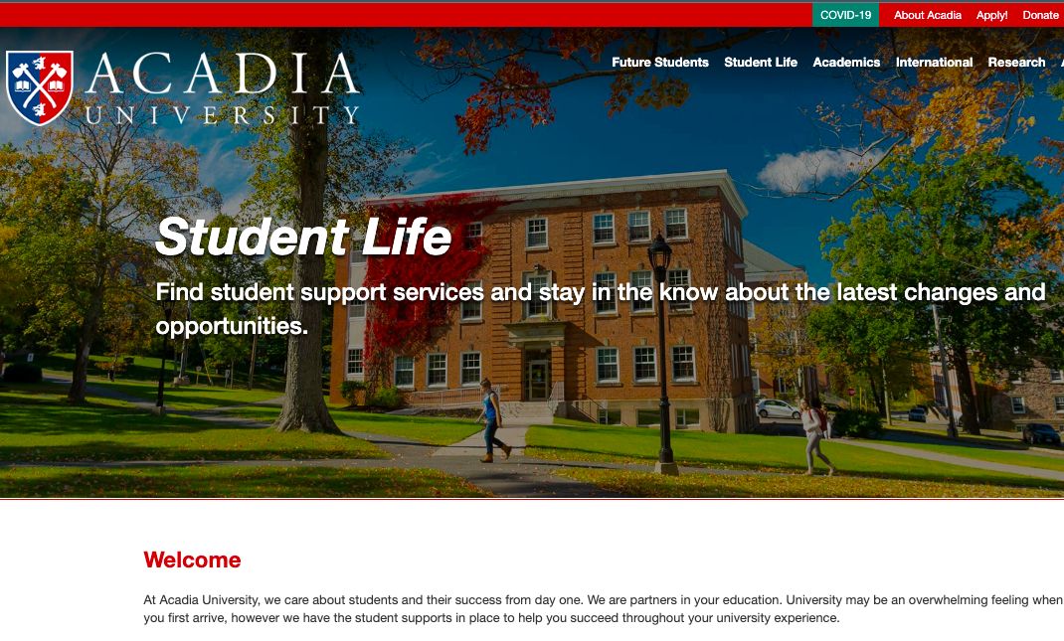
Additional Supports on Campus
Counselling Services
Accessible Learning Services
Student Health Centre
Vaughn Memorial Library
Writing Centre
Women’s Centre
Notes:
Matt D

Slide 17
Grades....take it in stride
Aim for learning, not As...
We know, we've been there, that is easier said than done
Very normal for your first-year grades to be lower than you're used to
Different expectations
More independent work and responsibility
Learning curve comes with different style of teaching and learning
Different grade scales…a "C" is "average".
1st year course averages are typically 65%-70% (C+ to B-)
Notes:
Acacia

Slide 18
What electives should I take?
University is about personal and professional growth...choose with this in mind!
Expand one’s global and self-awareness, critical thinking, and communication skills
Ask other students about their experience
Increase your knowledge of a specialized area in your chosen career path or field
Taking classes on new subjects is incredibly important to intellectual and personal growth
Develop new ways of thinking
Develop a broader social circle
Engage in the world in new ways
Notes:
Acacia

Slide 19
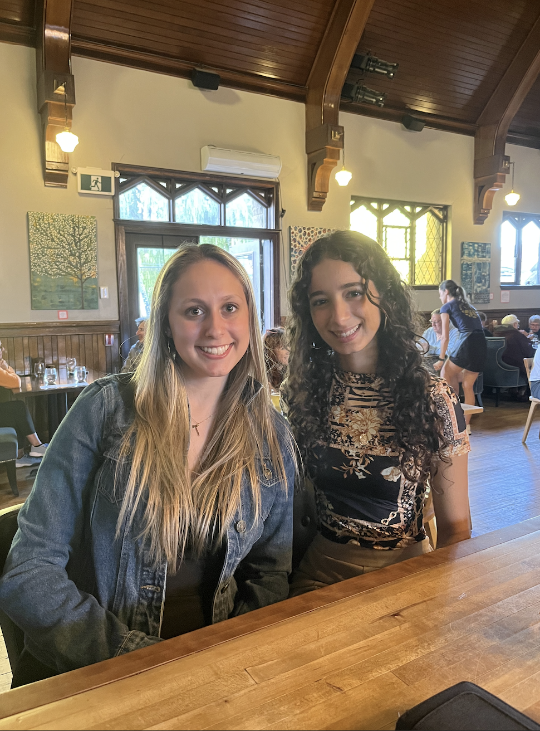
Acadia Food and Nutrition Society (AFNS) Co-Presidents, Kiana Knelsen: 161905k@acadiau.ca Maria Henein: 161502h@acadiau.ca
What We Do
Bi-weekly meetings
Weekly meetings for Exec team
Plan and host educational, fundraising, and social events (ie. Trivia Night, coffee house, end of year banquet, pizza social, Christmas party, yoga, and more...)
Why You Should Join!
To become more involved in the Nutrition department
Meet new people & professors
Resumé builder
Improve planning & organizing skills
Fun and exciting events to attend, plan and volunteer

Slide 20
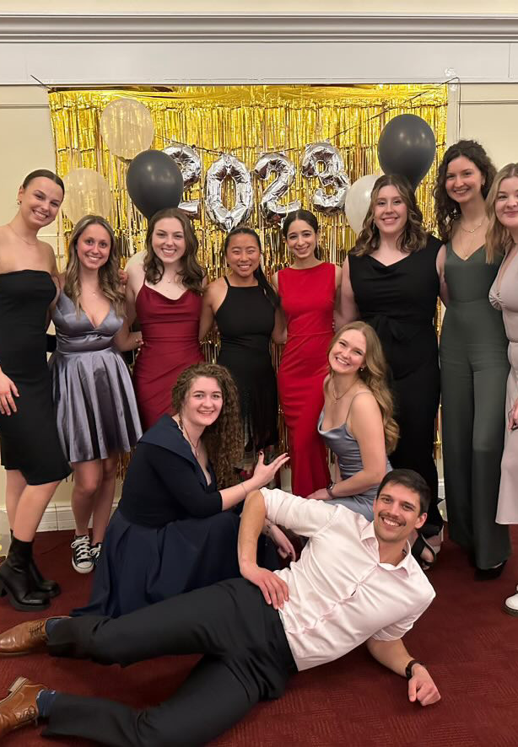
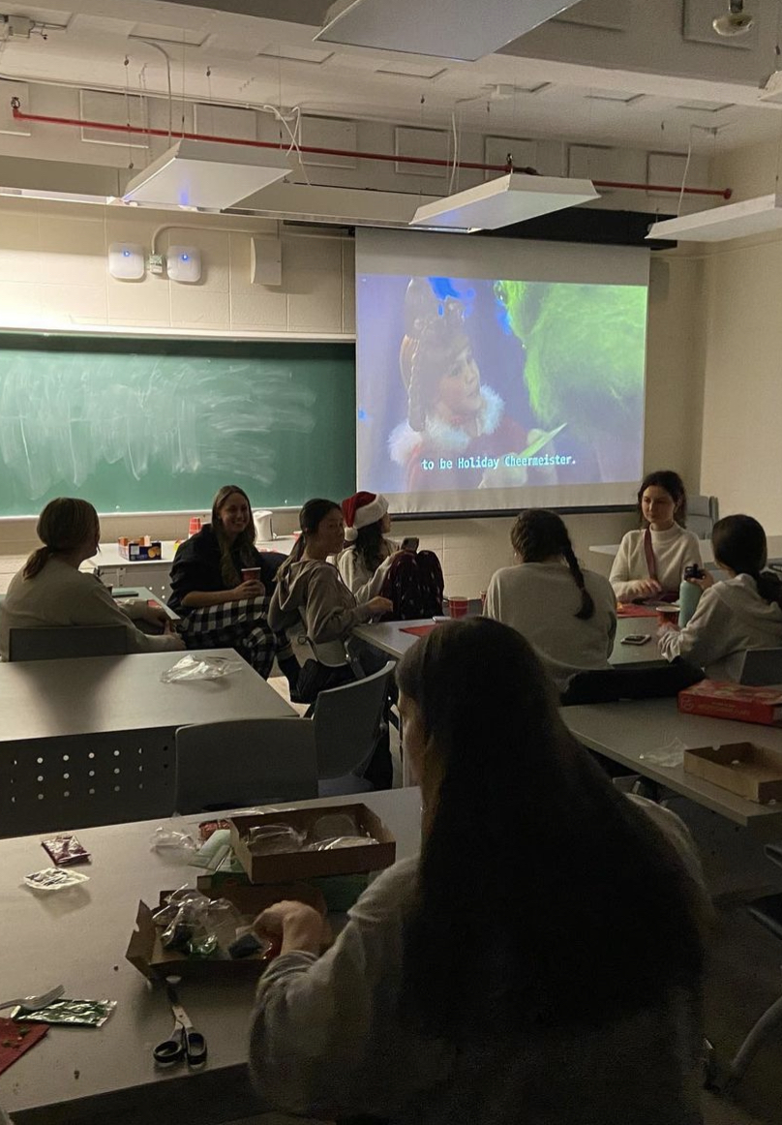
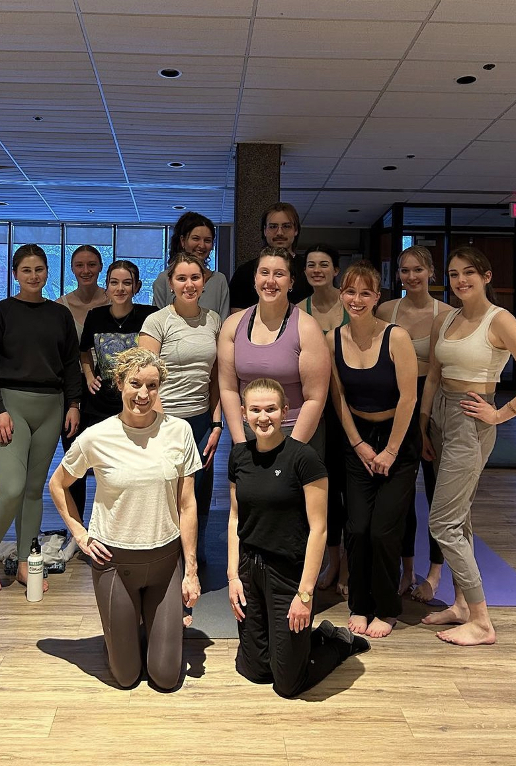
Instagram: @afns.acadiau
Executive Team: Co-Presidents, Co-vice Presidents, Social, Education, Fundraising, Educational, Treasurer, Communications, 2nd year Rep
Seeking for 1st year rep right now, if interested please contact Kiana or Maria
$2 Membership Fee
Calendar in Student Lounge (4th floor Huggins)
Please check email regularly for most up to date information on events, and Instagram for reminders

Slide 21
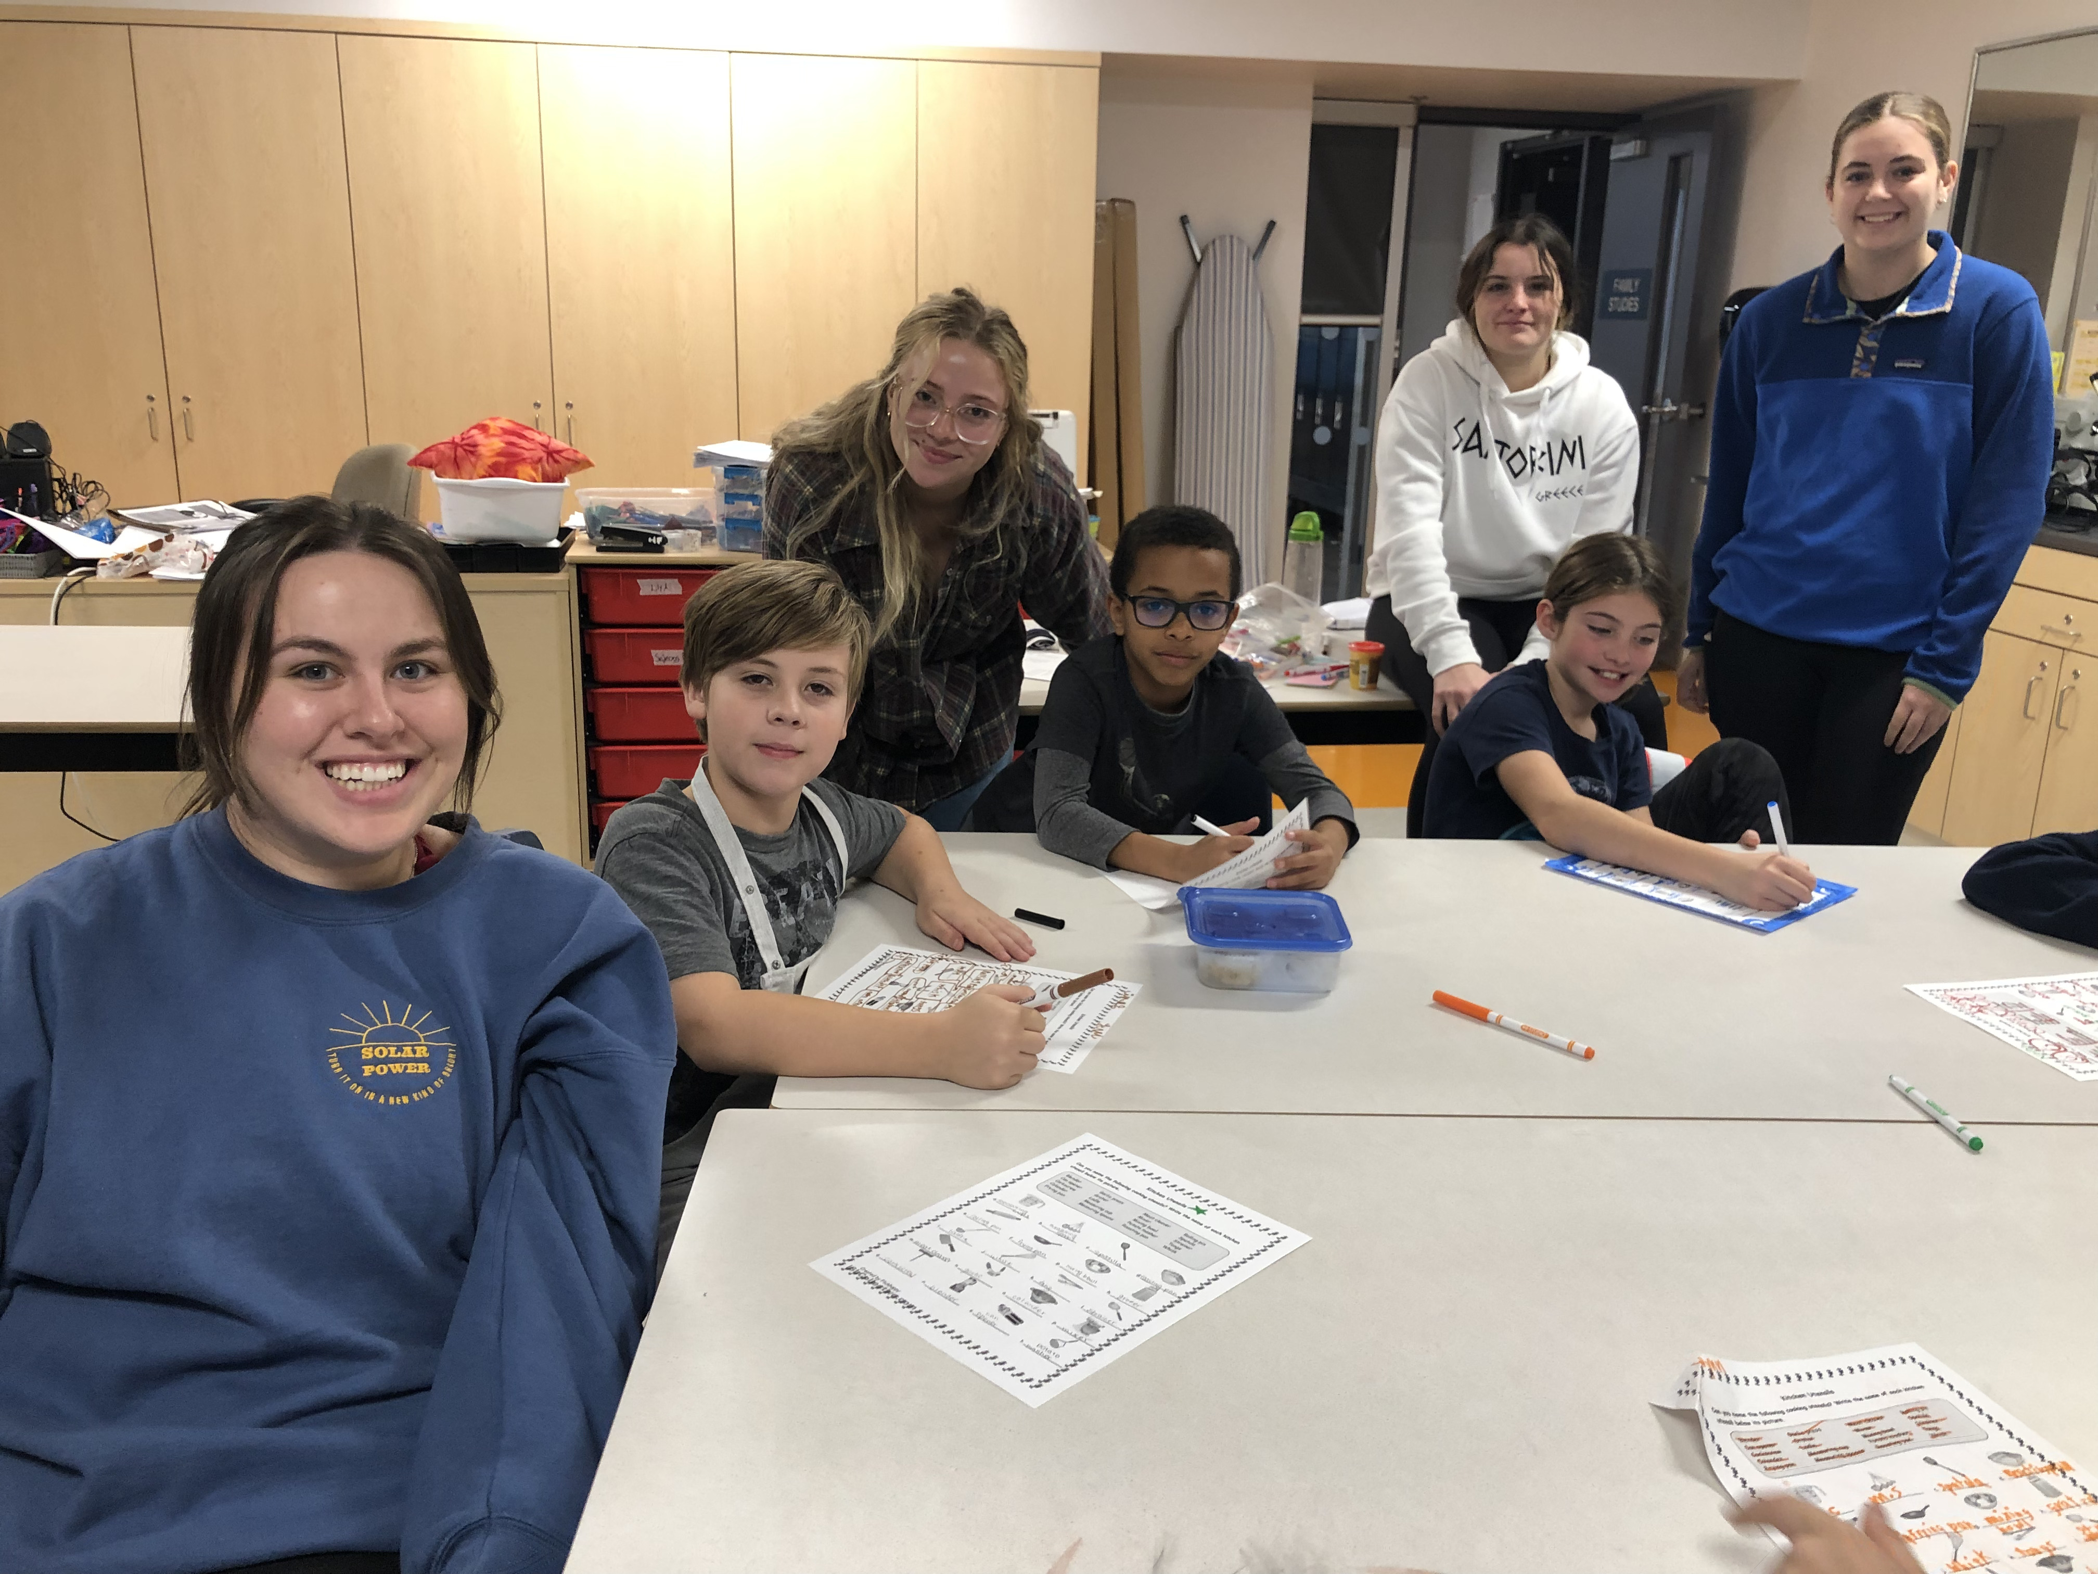
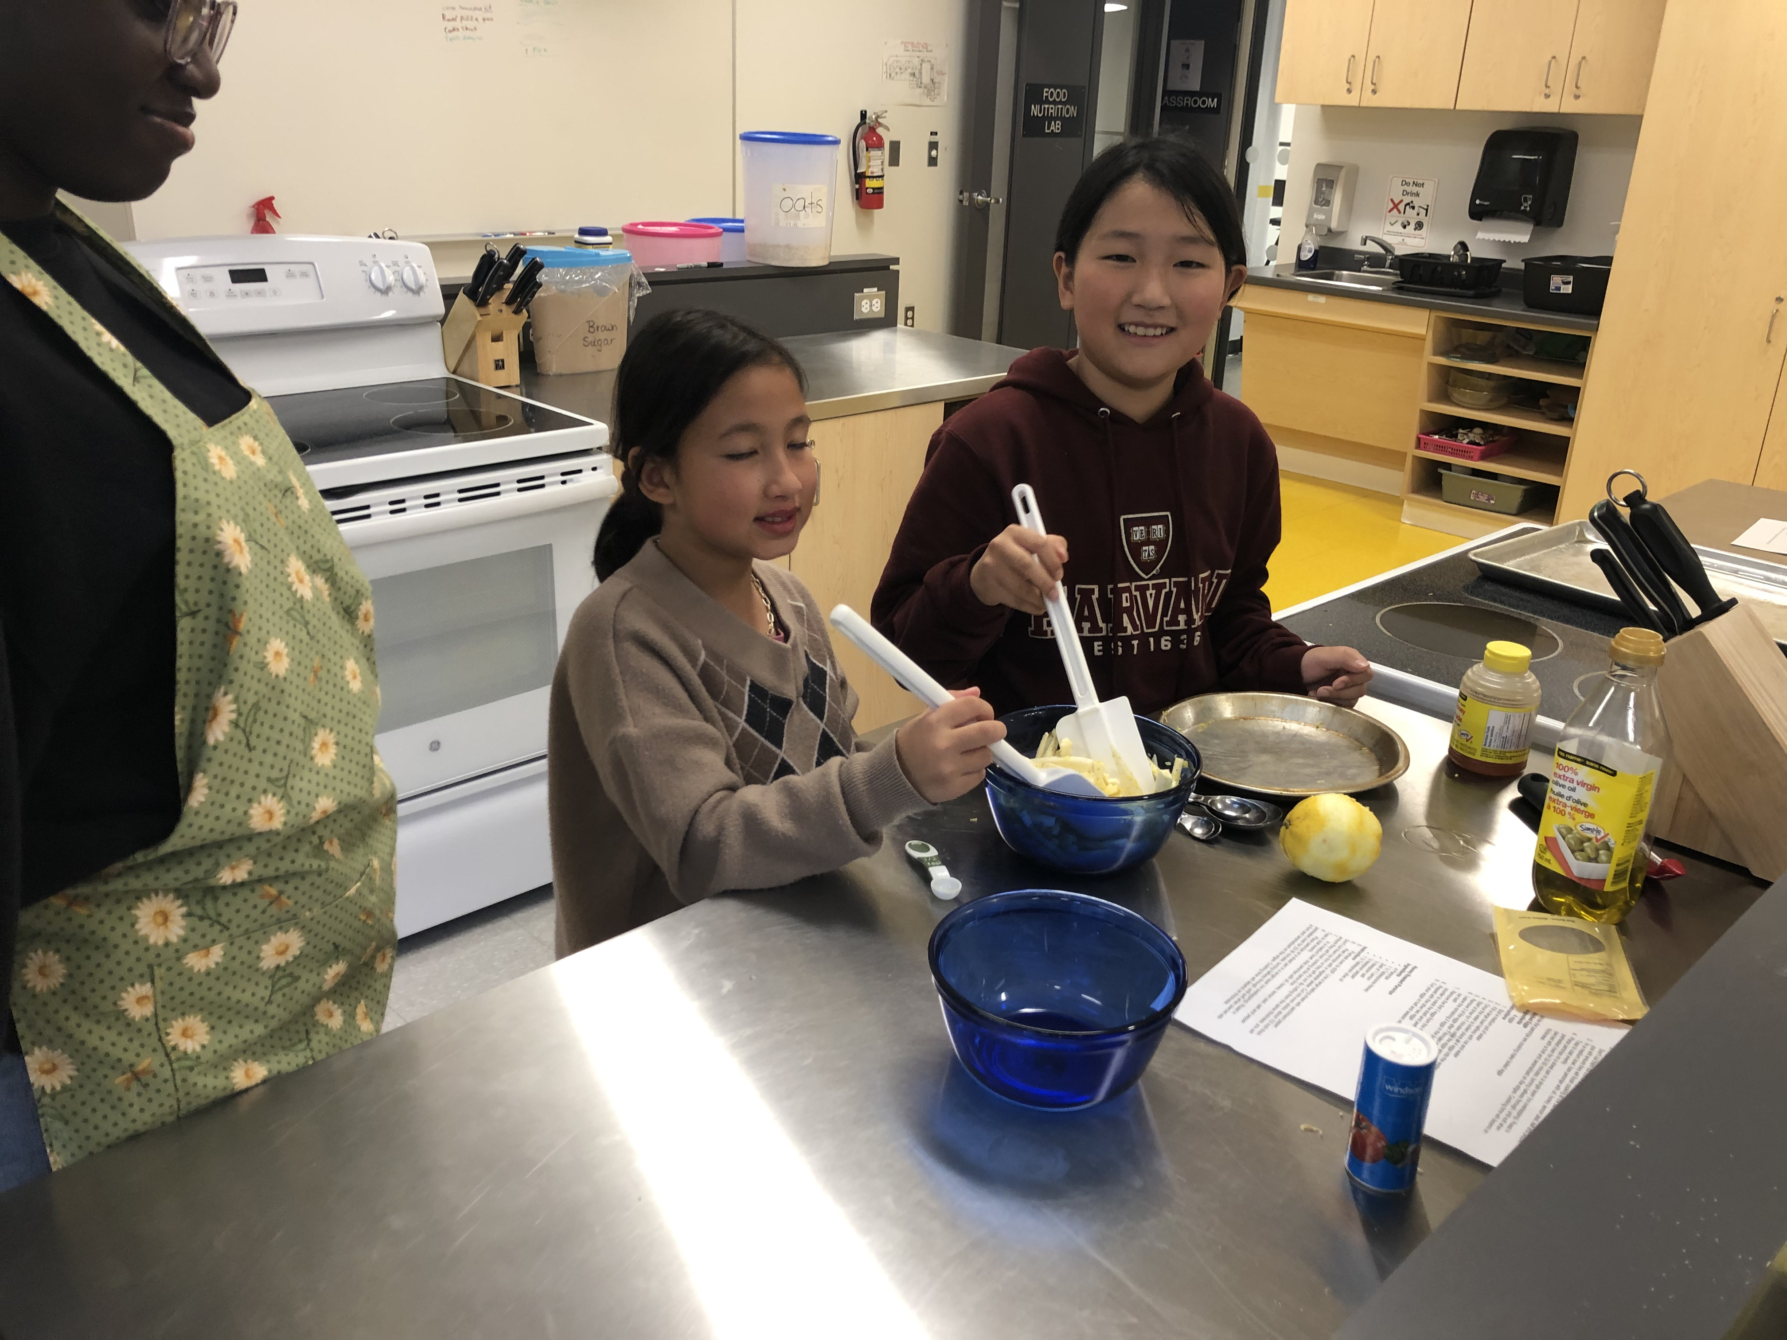
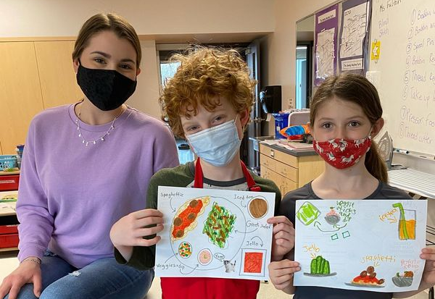
Children's Health & Nutritional Growth Experience (CHANGE) IG & FB: @changeacadia
Coordinator, Elizabeth Cox: 160639c@acadiau.ca Assistant Coordinator, Maggie Furlong
Faculty supervisor: Acacia Puddester
A partnership program between Acadia and the Wolfville School
Our goals:
Increase nutrition literacy and food skills in school children
Allow volunteers to gain valuable leadership skills
Strengthen the relationship between children, volunteers, and the Wolfville community
We meet on selected Wednesday/Friday afternoons for 3 hours – starting at the beginning of second semester
Volunteers may:
Assist with planning in one of the program coordinator roles
Work directly with kids during the program as a general volunteer
Program activities include:
Cooking & food skills
Active games
Nutrition education
Contact Elizabeth with any questions and watch for an email from Lynn with our volunteer application
Notes:
Elizabeth Cox

Slide 22
Nutrition Peer Mentor Program Coordinator, Melanie Walsh: 0210955w@acadiau.ca
Learn to navigate university life (e.g. res life, places on campus to study, places to hang out in Wolfville)
Connect with 3rd and 4th year students
Get advice and guidance (e.g. housing after res, courses, career paths, practicum apps)
Learn more about the School of Nutrition and Dietetics and ways to get involved
No time commitment…just contact your mentor when you would like to meet or when questions arise
Notes:
Melanie

Slide 23
SND Support Centre
Supports SND students and department operations
Stay tuned for updates!
Notes:
Do we keep this?

Slide 24
Reach out! Stay connected…
Lynn Coleman: lynn.coleman@acadiau.ca
Connie Foote: connie.foote@acadiau.ca
School of Nutrition and Dietetics: SND Website
Twitter: @AcadiaNutrition

Slide 25
More information to come
BSN Degree options and double majors
Employment, academic, and practicum references
Co-op education
Acadia exchange program
Career options
Honours research
Acadia’s Dietetic Practicum Program
And more!
Notes:
Connie

Slide 26
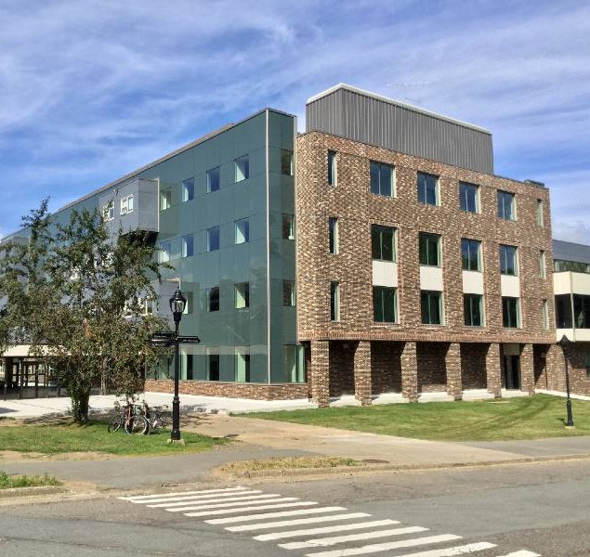
Most Importantly!
You have worked hard to be here; you belong here.
Congratulations on your achievements, and welcome to the School of Nutrition and Dietetics.
We are excited you are here, and we know you will have a great year!

Slide 27
Tour of 4th Floor Huggins
Notes:
Student led??
Lily Stanwood
Jillian and Melanie - Team

