Slide 1
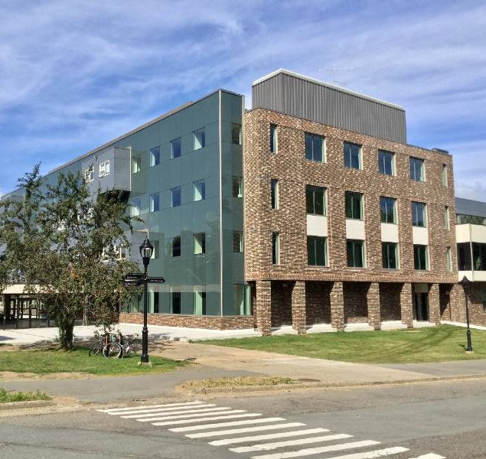
School of Nutrition & Dietetics
Welcome to SND!
Congratulations on your achievements.
You have worked hard to be here.
Make yourself at home. ​
Fall 2025 Orientation

Slide 2
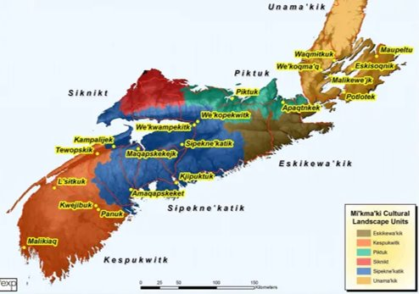
Acadia University is located in Mtaban (Wolfville), Mi'kma'ki (Nova Scotia), the ancestral and unceded territory of the Mi'kmaq, Peskotomuhkati (Passamaquoddy), and Wolastoqiyik (Maliseet) people, on the east coast of Turtle Island (Canada).
The land, relationships, and our roles and responsibilities as treaty people are governed by the Treaties of Peace and Friendship, 1725-1779.
Find out more about where you are from, where you live, work, and play at Whose Land?
Maps courtesy of Ta’n Weji-squlia’tiek (Mi’kmaw Place Names and Digital Atlas) https://www.mapdev.ca/placenames/
Notes:
Jen

Slide 3
SND
The School of Nutrition and Dietetics is for …learning about nutrition, food and health.
We aim to inspire and compel our students to learn, question, and develop into well-rounded, competent, independent nutrition leaders.
Our outcomes are recognized locally and nationally.
Fall 2025 Orientation

Slide 4
SND Program Objectives
1. Prepare students with foundational and applied knowledge in food, nutrition and dietetics, incorporating and valuing:
    Professional written and oral communication skills
    Critical thinking and reflection abilities
    Client centeredness
    Teamwork, collaborative learning, community service and leadership
    Commitment to emerging evidence
2. Prepare students to apply for careers of their choice
3. Prepare students for professional and ethical practice
Fall 2025 Orientation

Slide 5
How to Succeed in SND
Show up as you can
Be curious and humble
Support and respect your peers
Strive for learning, not for grades
Take good notes, you can't remember it all
Pay close attention to instructions
Figure out how to answer your own questions
Ask for help when you need it
Keep showing up as you can
Fall 2025 Orientation

Slide 6

Where else to go with questions?
Course syllabi
Moodle
Course professor
SND Student Handbook
Academic Calendar
Registrar’s Office
Financial Services
ASU
Academic Supports
Health Supports
Fall 2025 Orientation

Slide 7
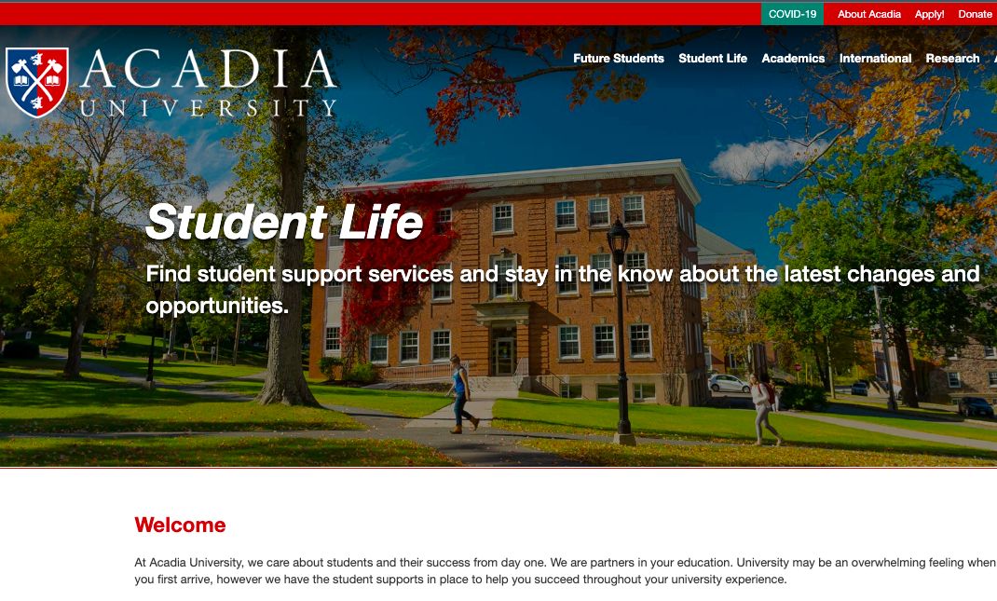

Additional Supports on Campus
Counselling Services
Accessible Learning Services
Student Health Centre
Vaughn Memorial Library
Writing Centre
Women’s Centre
Notes:
Matt D

Slide 8
More Info Coming…
Communication tips
BSN Degree options and double majors
Employment and academic references
Career options
Co-op education
Acadia exchange program
Honours research
Acadia’s Dietetic Practicum Program
Fall 2025 Orientation
Notes:
Connie

Slide 9
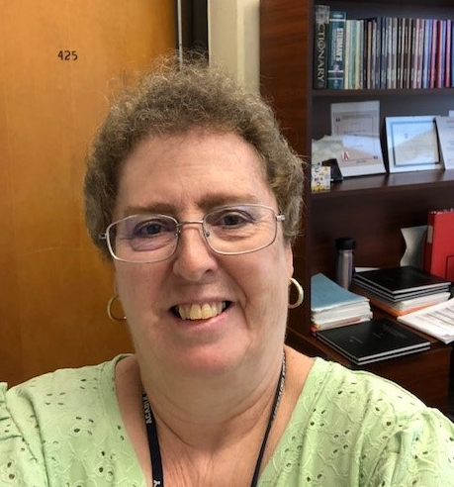
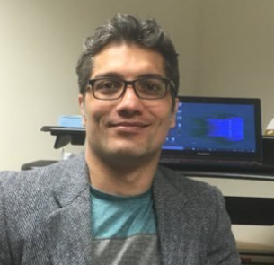
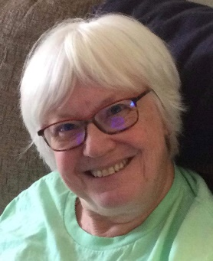
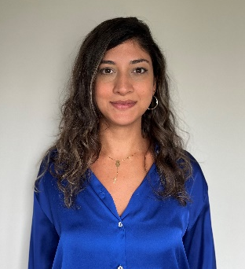

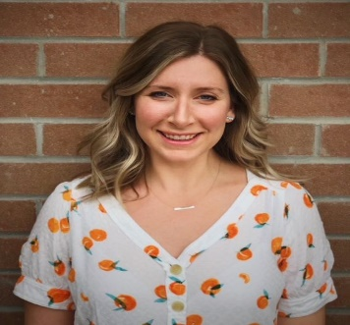

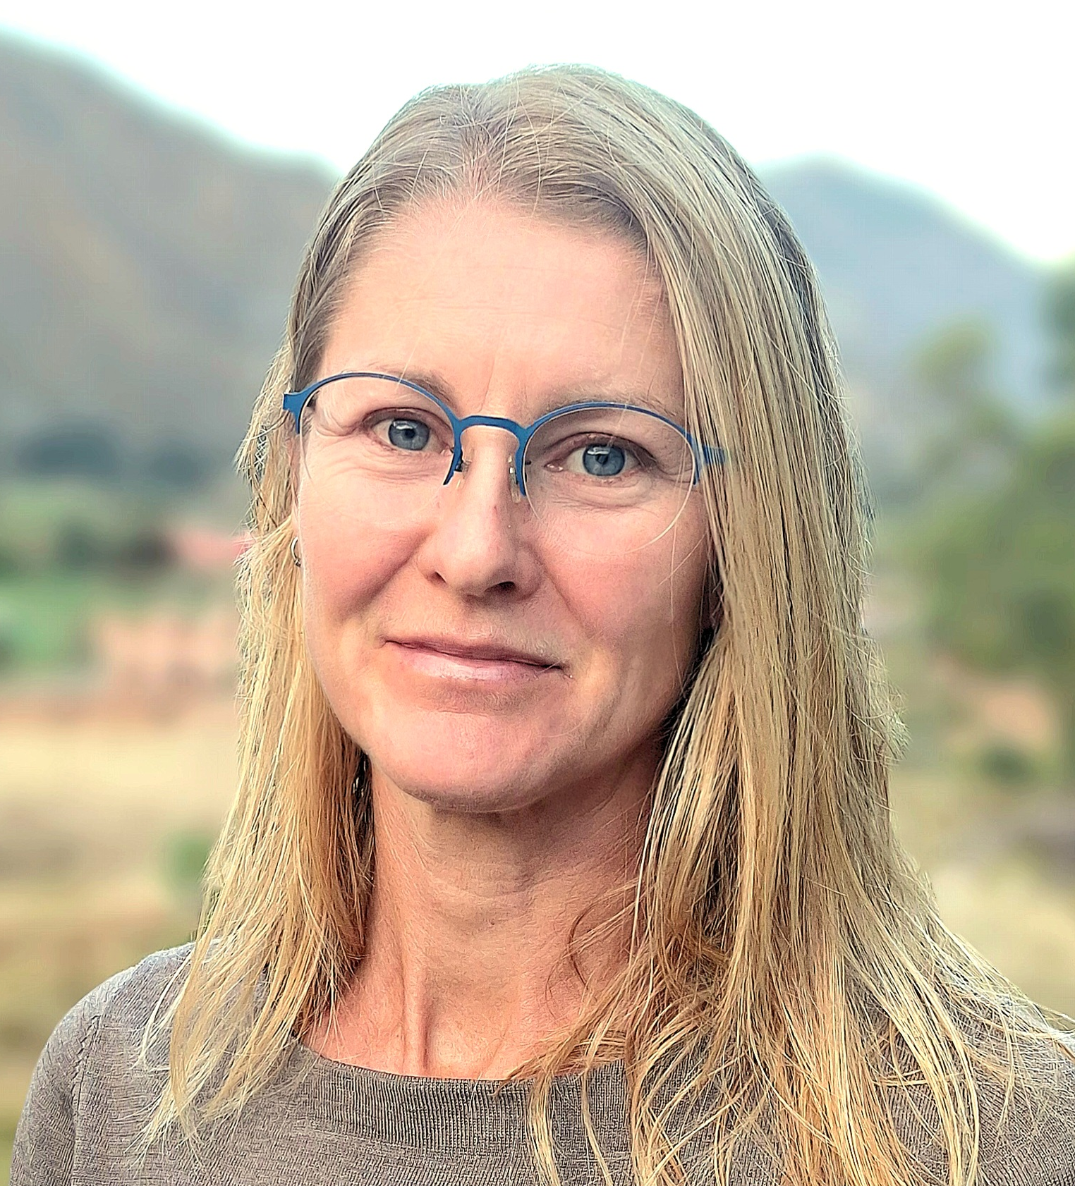

Meet Our Faculty and Staff
Here today to introduce themselves
Lynn Coleman (Admin Assistant)
Dr. Mojtaba Kaviani
Judy Lowe
Jamal Amyoony
Acacia Puddester
Laurel Ettinger
Dr. Matt Durant
Dr. Liesel Carlsson (Interim Director)
Dr. Matt McSweeney (on leave)
Dr. Jane Francis
Please see the bulletin board by the stairs for introductions to our other team members!
Fall 2025 Orientation
Notes:
All...briefly say hello, welcome, and share an elevator pitch of your research and teaching
Update and add pictures

Slide 10
What do these folks do all day?
Administrating/Coordinating
  Supporting students and faculty with the administrative work required to succeed
Teaching
  Teaching courses (5)
  Practicum supervision
Research
  Planning and funding, collecting and analyzing data
  Publishing
Service
  Committees etc. at Acadia, in community and industry
  Coaching
Fall 2025 Orientation
Notes:
Jen

Slide 11

How do I address my course instructors?
Best to start off using Dr. XYZ until invited otherwise by the course instructor
Cordial, courteous, and semi-formal tone and language
Punctuated and grammatically correct text
Clear, concise message and subject line with course code and name if appropriate

Slide 12

BSN Programs and Advising Sheets
Our BSN degree is a four-year program if you take and pass five courses in each fall and winter term
Core nutrition courses are only offered once per academic year
Many first- and second-year courses are prerequisites for third- and fourth- year courses
Careful planning is important; make use of the BSN advising sheets found here on SND website
Notes:
Lynn

Slide 13

Self-Service
(aka Colleague)
How do I login?
  https://www2.acadiau.ca/myacadia.html
What do I use self service for?
Who do I ask if I am having problems with Colleague?
  Registrar’s Office
  Lynn Coleman

Slide 14
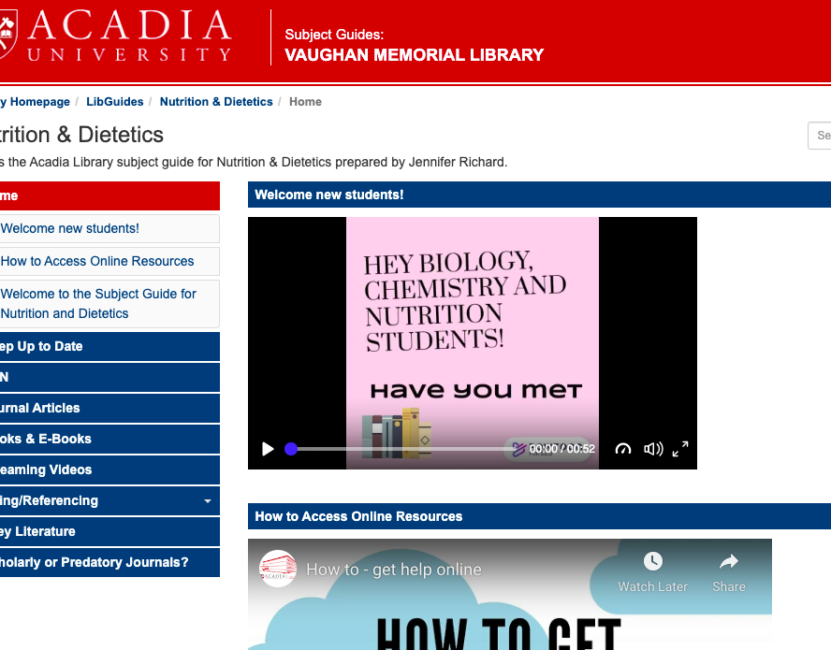
The Library... an indispensable resource!
Readings, research, & referencing
Access the library's excellent resources here:
  https://libguides.acadiau.ca/nutr
  Hailey Wills is the subject librarian for Nutrition and Dietetics
Notes:
Matt D

Slide 15

The Writing Centre
The Writing Centre offers free help to students wanting to improve their writing skills. You can sign up online today:
  To book a one-to-one appointment with a trained writing tutor, click here:
    writingcentre.acadiau.ca/writing-tutorials.html
  To see which helpful presentations and workshops you’ll want to attend this year, click here:
    writingcentre.acadiau.ca/workshops-and-presentations.html
Notes:
Matt D

Slide 16

Grades....take it in stride
Aim for learning, not As...
  We know, we've been there, that is easier said than done
Very normal for your first-year grades to be lower than you're used to
  Different expectations
  More independent work and responsibility
  Learning curve comes with different style of teaching and learning
  Different grade scales…a "C" is "average".
1st year course averages are typically 65%-70% (C+ to B-)
Notes:
Acacia

Slide 17

What electives should I take?
University is about personal and professional growth...choose with this in mind!
Expand one’s global and self-awareness, critical thinking, and communication skills
Ask other students about their experience
Increase your knowledge of a specialized area in your chosen career path or field
Taking classes on new subjects is incredibly important to intellectual and personal growth
  Develop new ways of thinking
  Develop a broader social circle
  Engage in the world in new ways
Notes:
Acacia

Slide 18
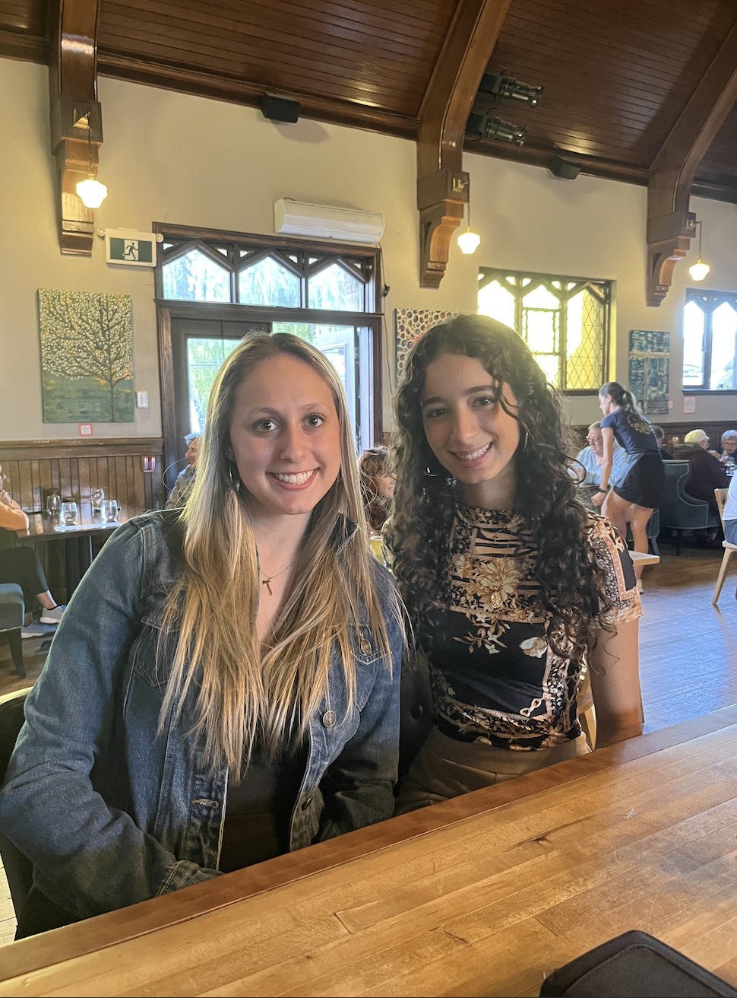
Acadia Food and Nutrition Society (AFNS)
What We Do
  Bi-weekly meetings
  Weekly meetings for Exec team
  Plan and host educational, fundraising, and social events (ie. Trivia Night, coffee house, end of year banquet, pizza social, Christmas party, yoga, and more...)
Why You Should Join!
  To become more involved in the Nutrition department
  Meet new people & professors
  Resumé builder
  Improve planning & organizing skills
  Fun and exciting events to attend, plan and volunteer

Slide 19
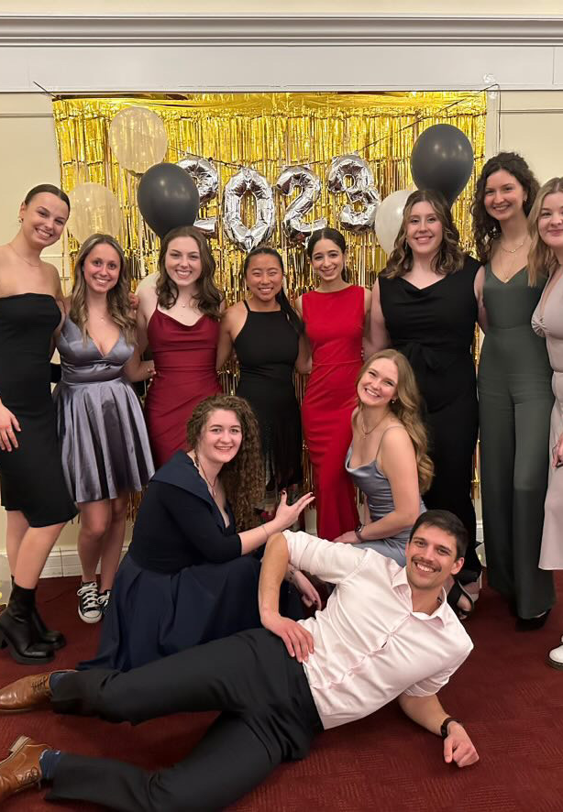
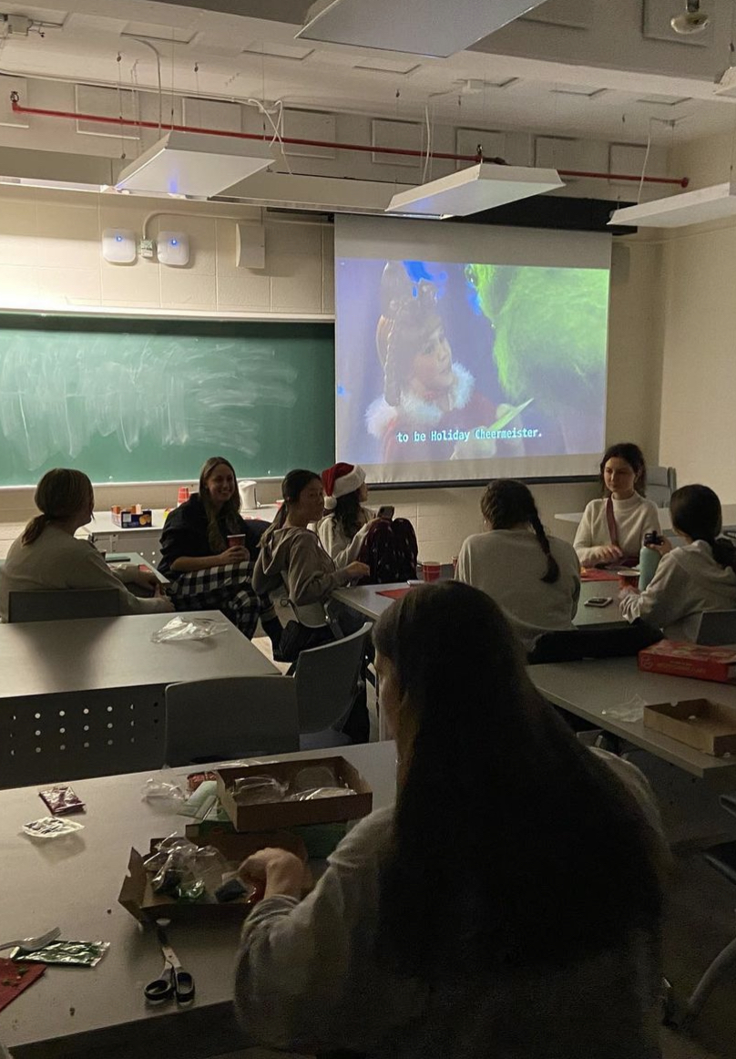
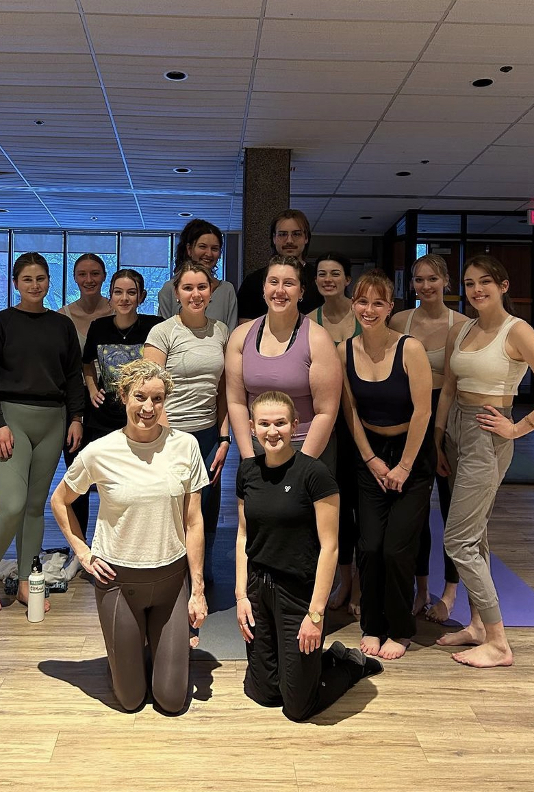
Instagram: @afns.acadiau
Executive Team: Co-Presidents, Co-vice Presidents, Social, Education, Fundraising, Educational, Treasurer, Communications, 2nd year Rep
Calendar in Student Lounge (4th floor Huggins)
Please check email regularly for most up to date information on events, and Instagram for reminders

